Slide 1
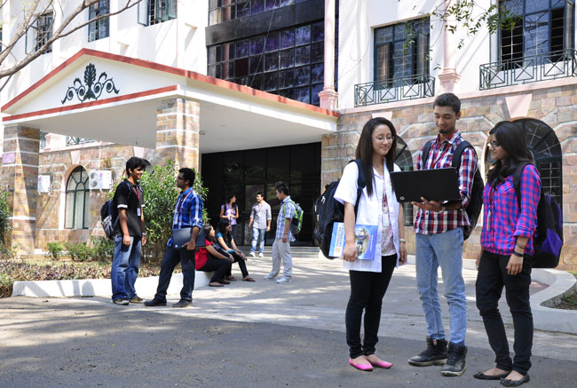

CSB4301 – Theory of Computation
B.Tech – IVth Semester
Mr. D.S.John Deva Prasanna AP(SG) & Ms.VanathiAP, CSE
Department of Computer Science and Engineering

Slide 2
Deterministic Finite Automata - DFA
This a type of Finite Automata
Every state in the automata will have at least one transition for every symbol given as input
(note here the input to the DFA is the symbols in the alphabet, hence denoted as ‘∑’).

Slide 3
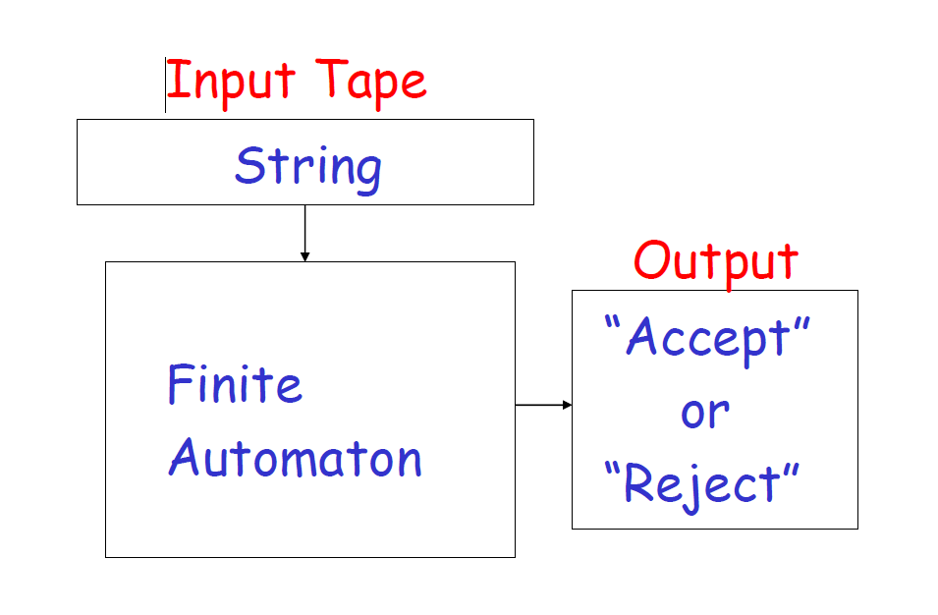
Schematic Diagram of a DFA

Slide 4
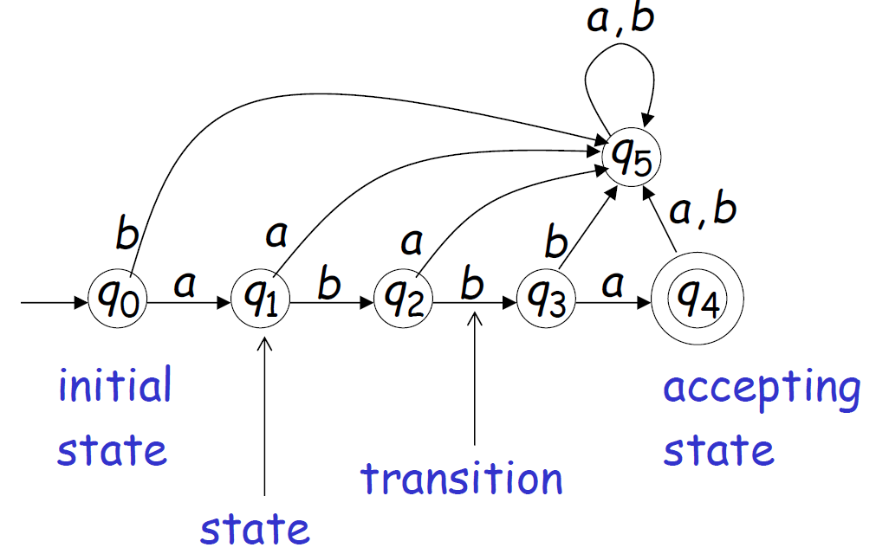

Slide 5
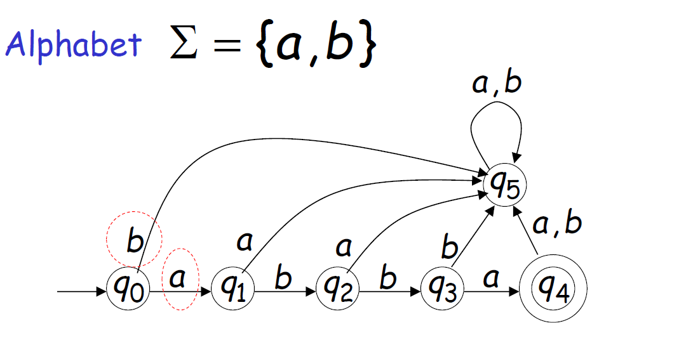
Every state in the DFA has a transition for every input symbol of the language.

Slide 6
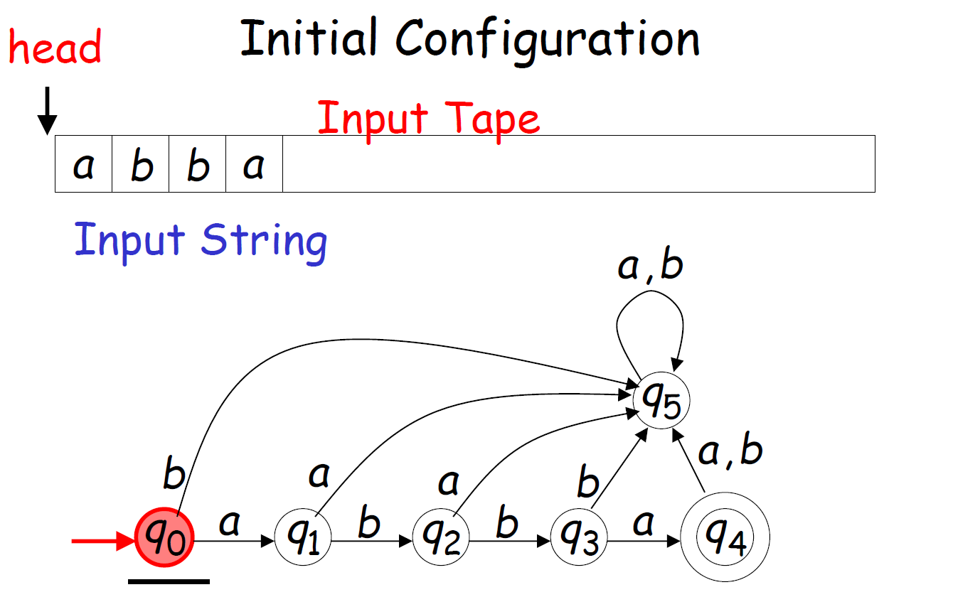

Slide 7
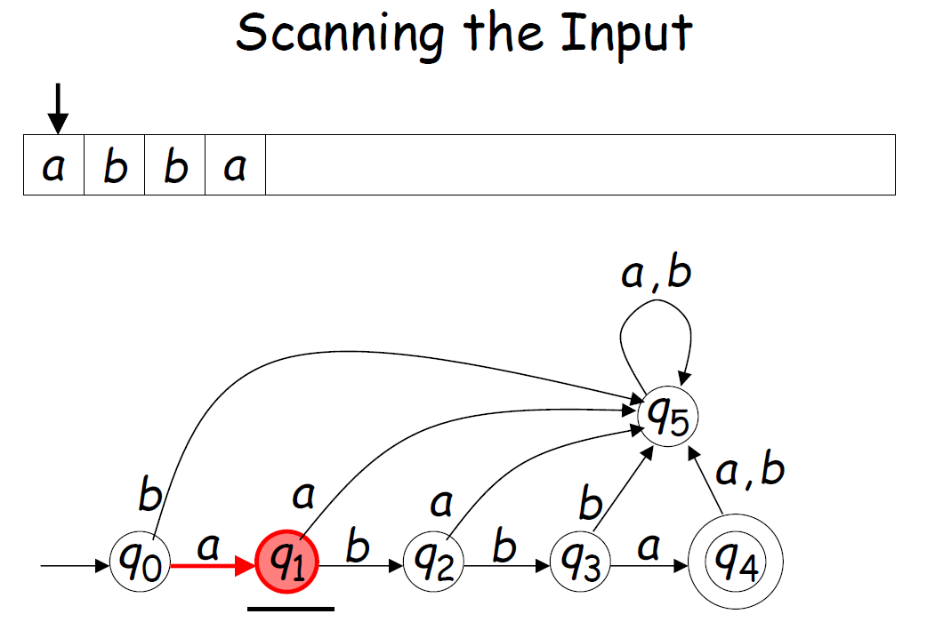

Slide 8
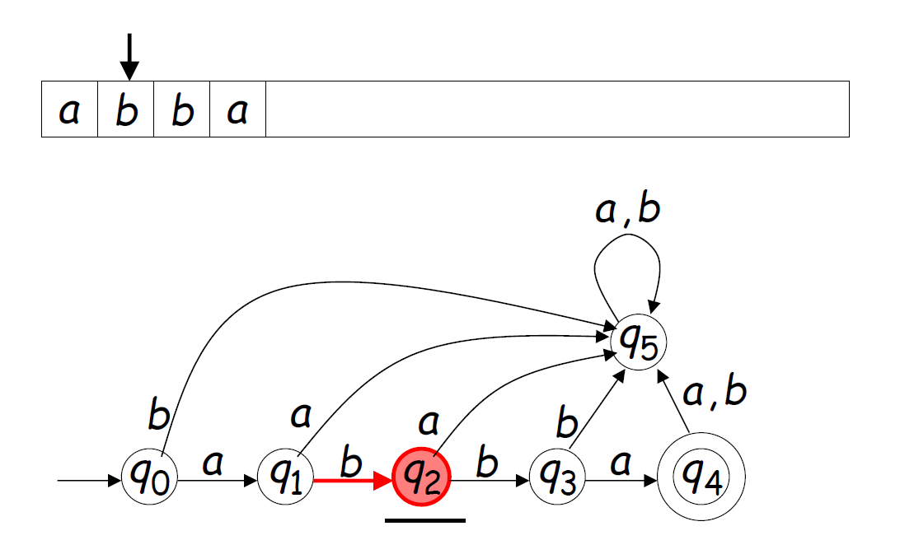
DFA Transition

Slide 9
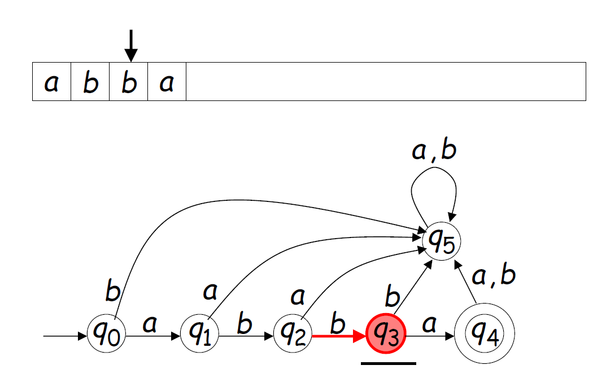
DFA Transitions

Slide 10
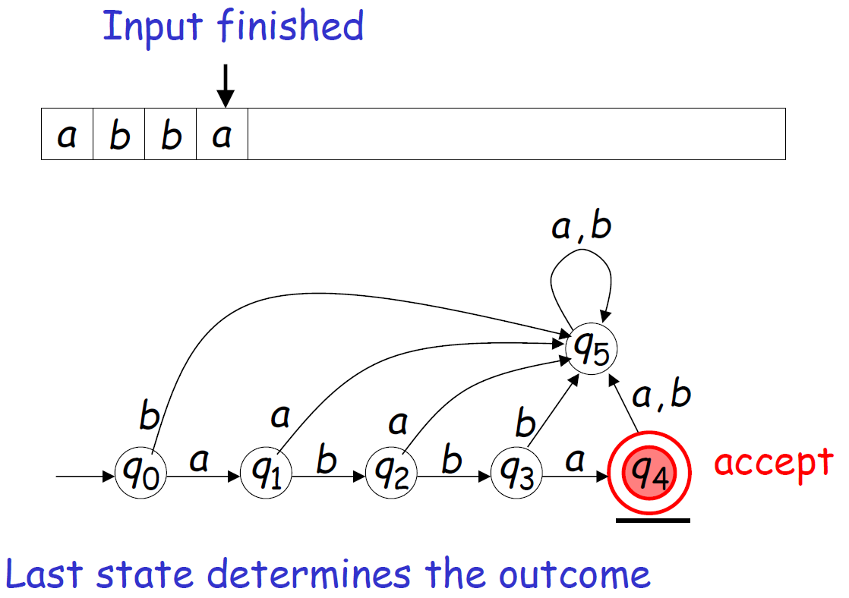

Slide 11
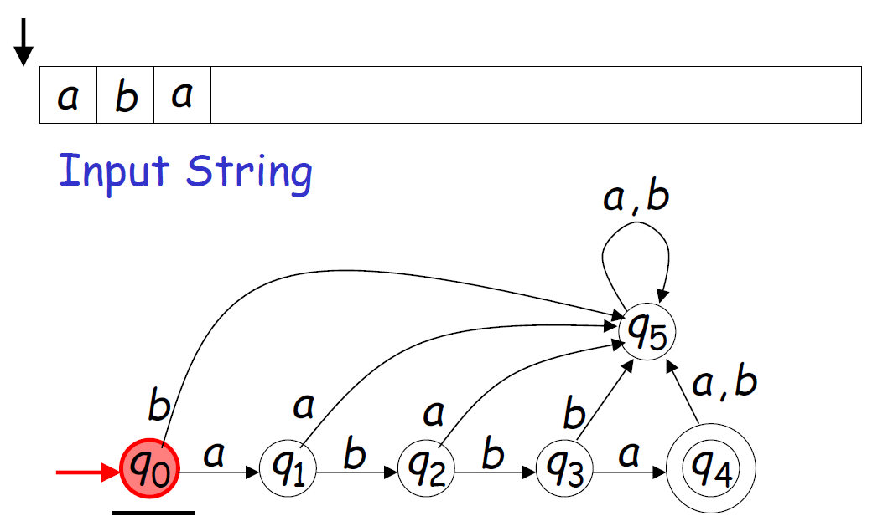
A Rejection Case

Slide 12
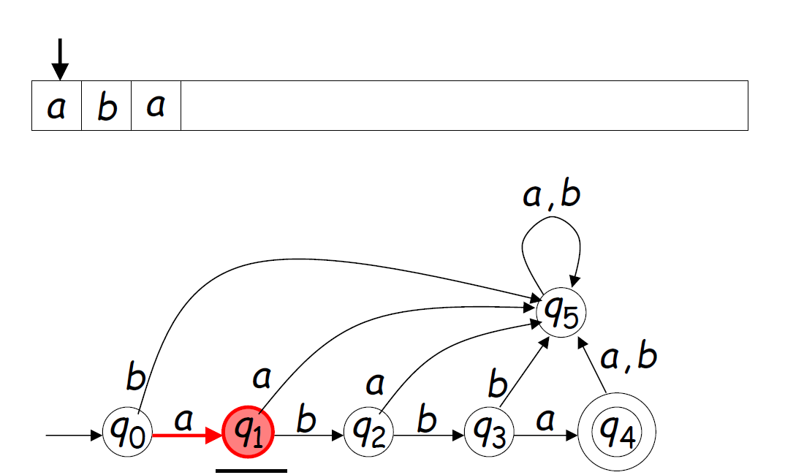
A rejection Case

Slide 13
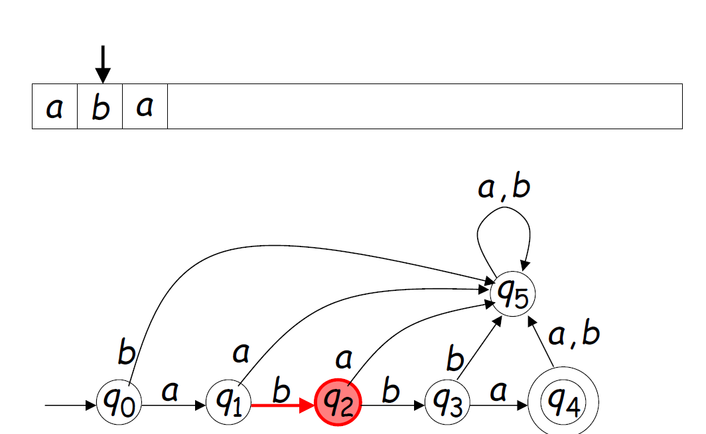
A Rejection Case

Slide 14
A Rejection Case

Slide 15
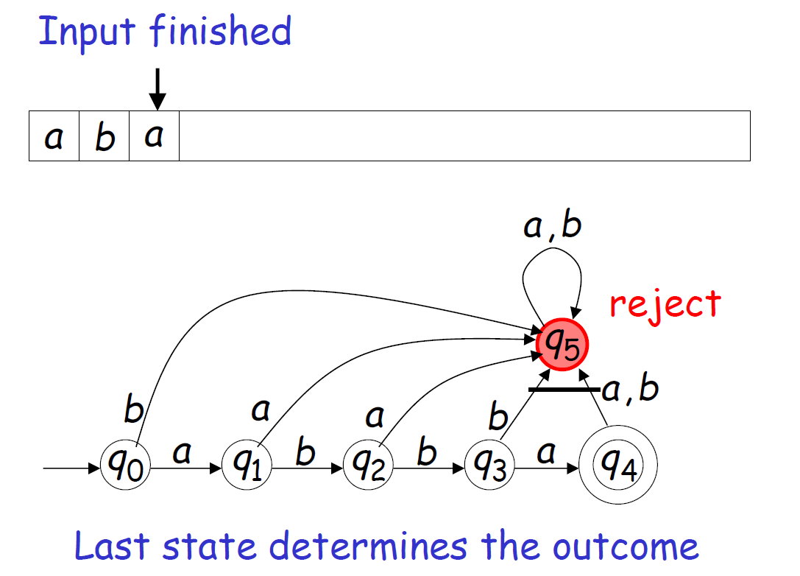
A Rejection Case

Slide 16
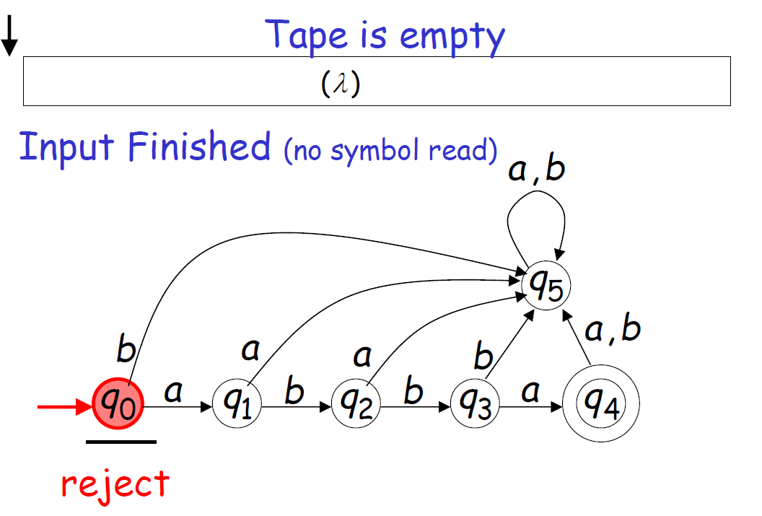
Another Rejection Case

Slide 17
Accepting / Rejecting conditions
Accepting
All input symbols are scanned and the final state is reached.
Rejecting
All input symbols are scanned and the last state is not an accepting state.

Slide 18
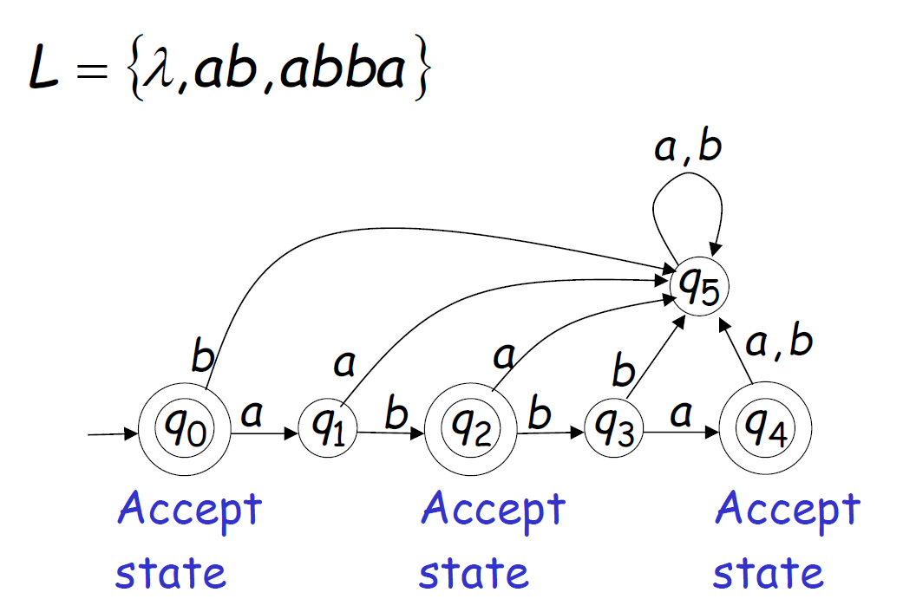
One more sample of DFA

Slide 19
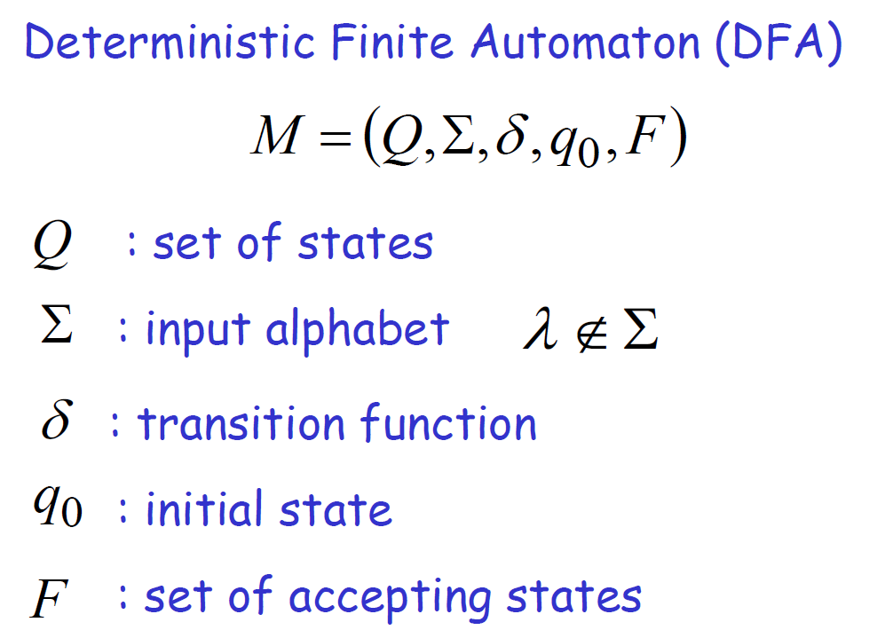
A Formal Representation of Deterministic Finite Automata – DFA A DFA ‘M’ can be represented using a five tuple

Slide 20
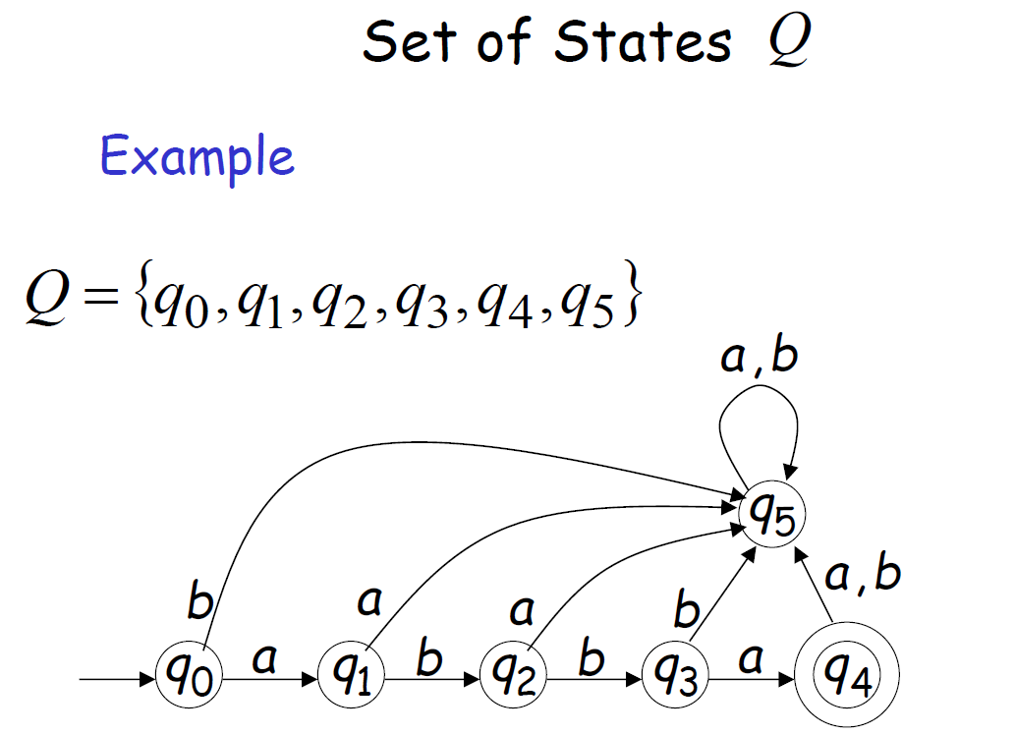
Deterministic Finite Automata – DFA – Set of States

Slide 21
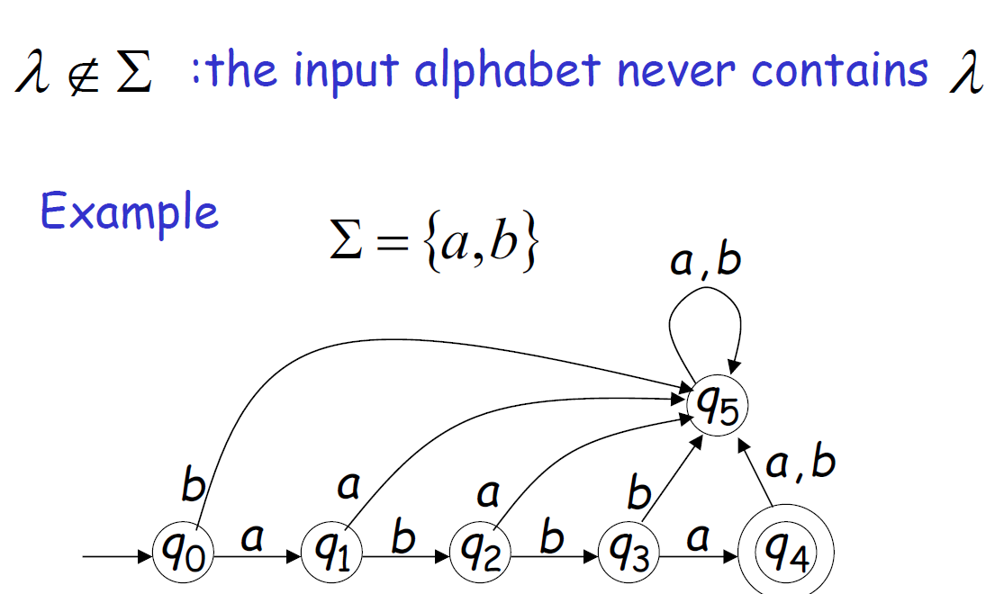
Deterministic Finite Automata – DFA- Input Symbols

Slide 22
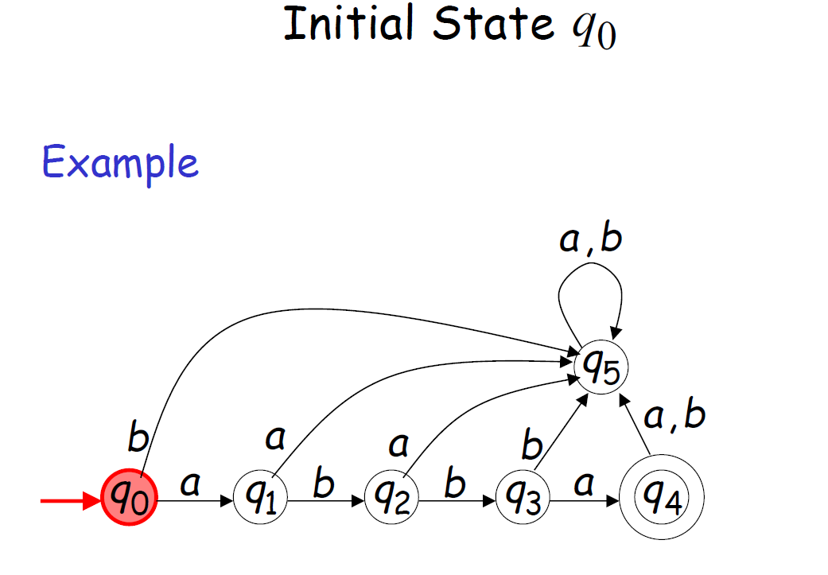
Deterministic Finite Automata - DFA

Slide 23
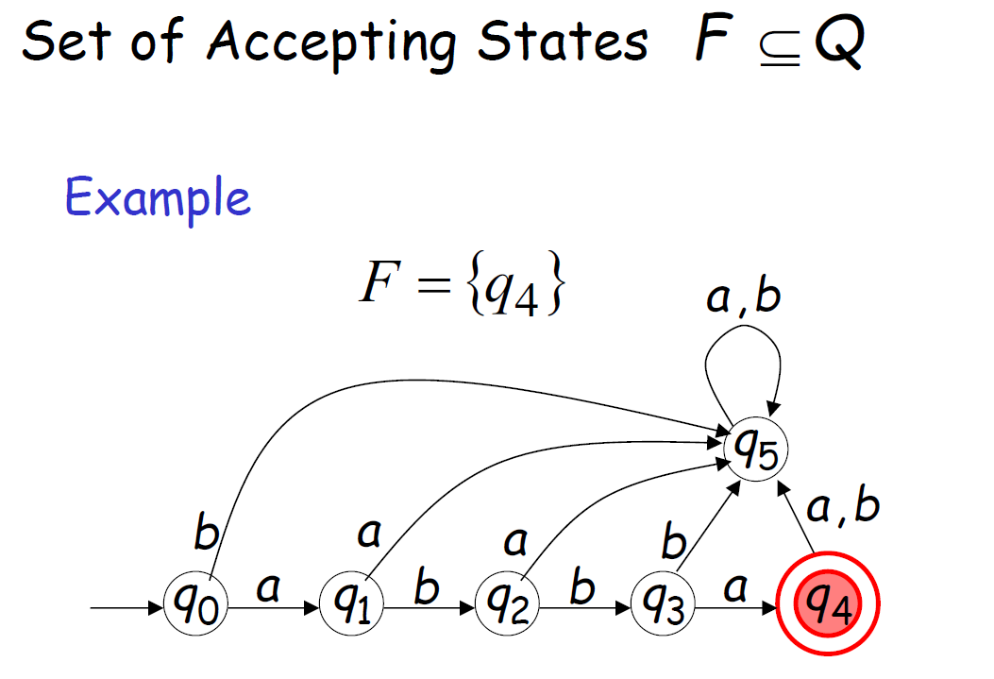
Deterministic Finite Automata - DFA

Slide 24
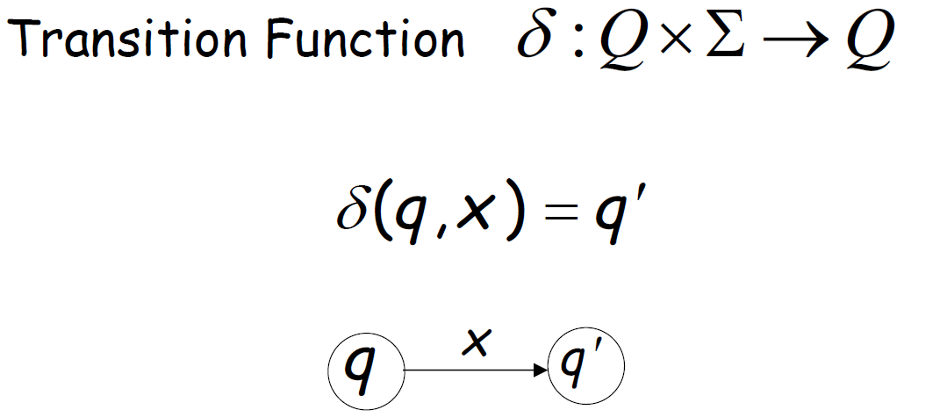
Deterministic Finite Automata - DFA

Slide 25
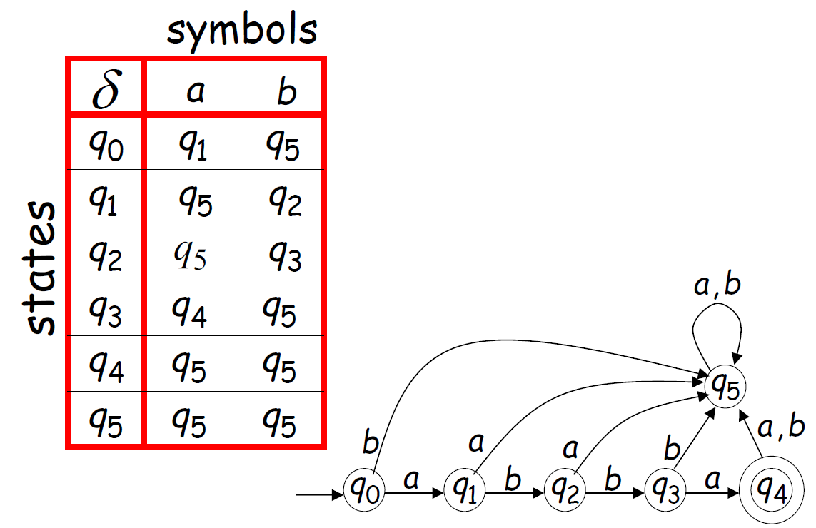
Deterministic Finite Automata – DFA – Transition Table

Slide 26
Thank You

